Slide 1
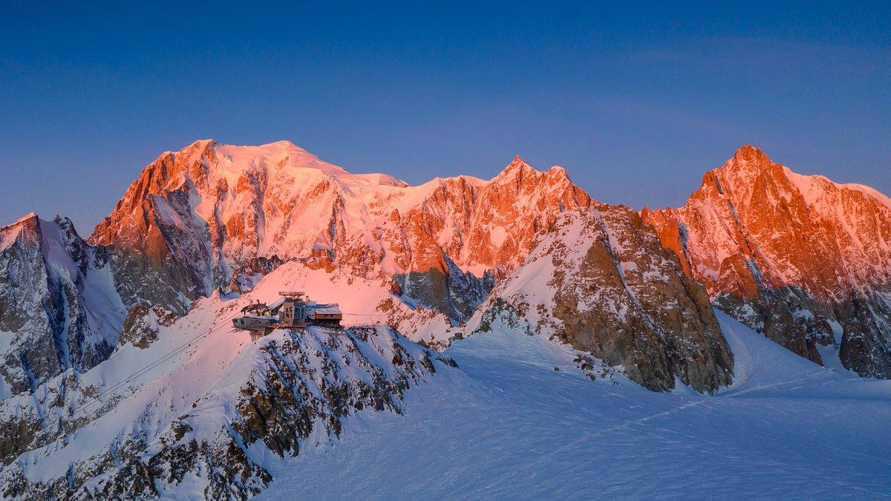

Turismo-Gestori infrastrutture e impianti a fune
Prepared by: Emanuele, Herman, Beatrice

Slide 2
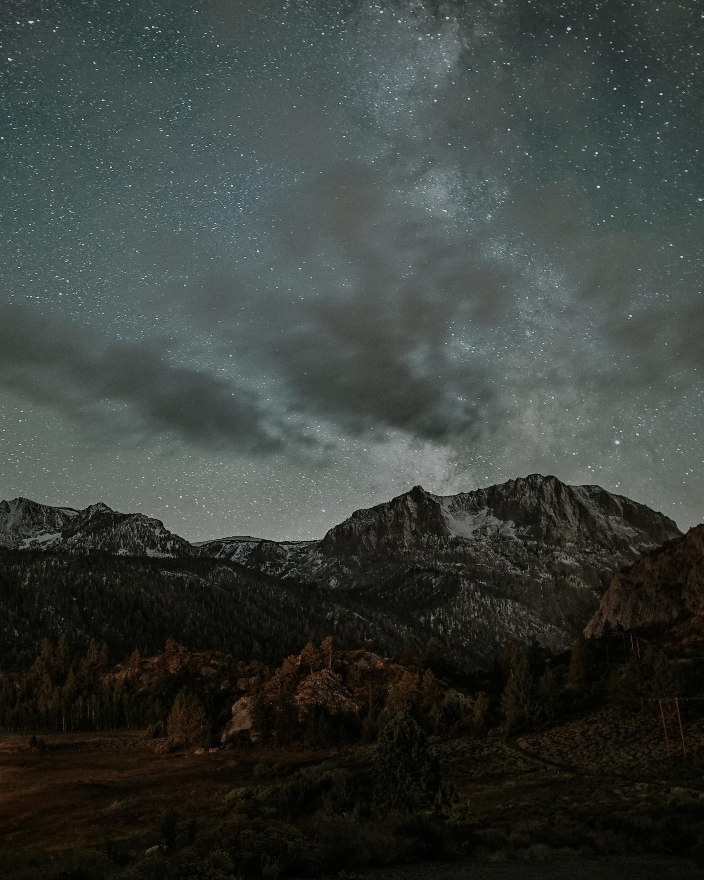
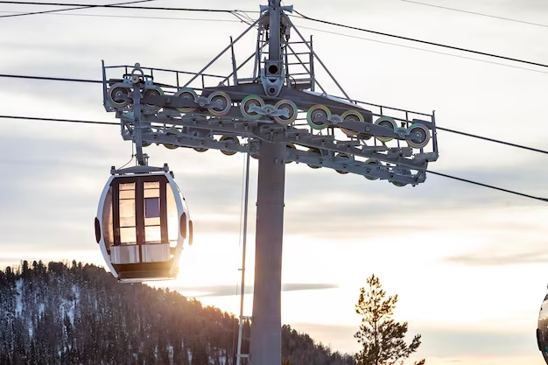
PROFESSIONE DI OGGI
Presentations are communication tools that can be demonstrations, lectures, speeches, reports, and more. Most of the time, they’re presented before an audience.
To create a stunning presentation, it's best to simplify your thoughts. Start with an outline of topics and identify highlights, which can be applied to whatever subject you plan on discussing.
PROFESSIONE DI OGGI
Manutentore Impianti a Fune
Manutentore Impianti a Fune
  Sicurezza e Manutenzione
- controlli periodici
- prevenzione di anomalie
- sostituzione componenti
  Conoscenza Tecnica & Elettronica
-conoscenza sistemi
-risoluzione problemi tecnici
-conoscenza principi di base
  Who We Are
  Popular Destinations
  Guided Tours
  Current Promotions
  Facts and Figures
  Our Team
  Contact Info
BIJOU TRAVEL & TOURS | 2020

Slide 3

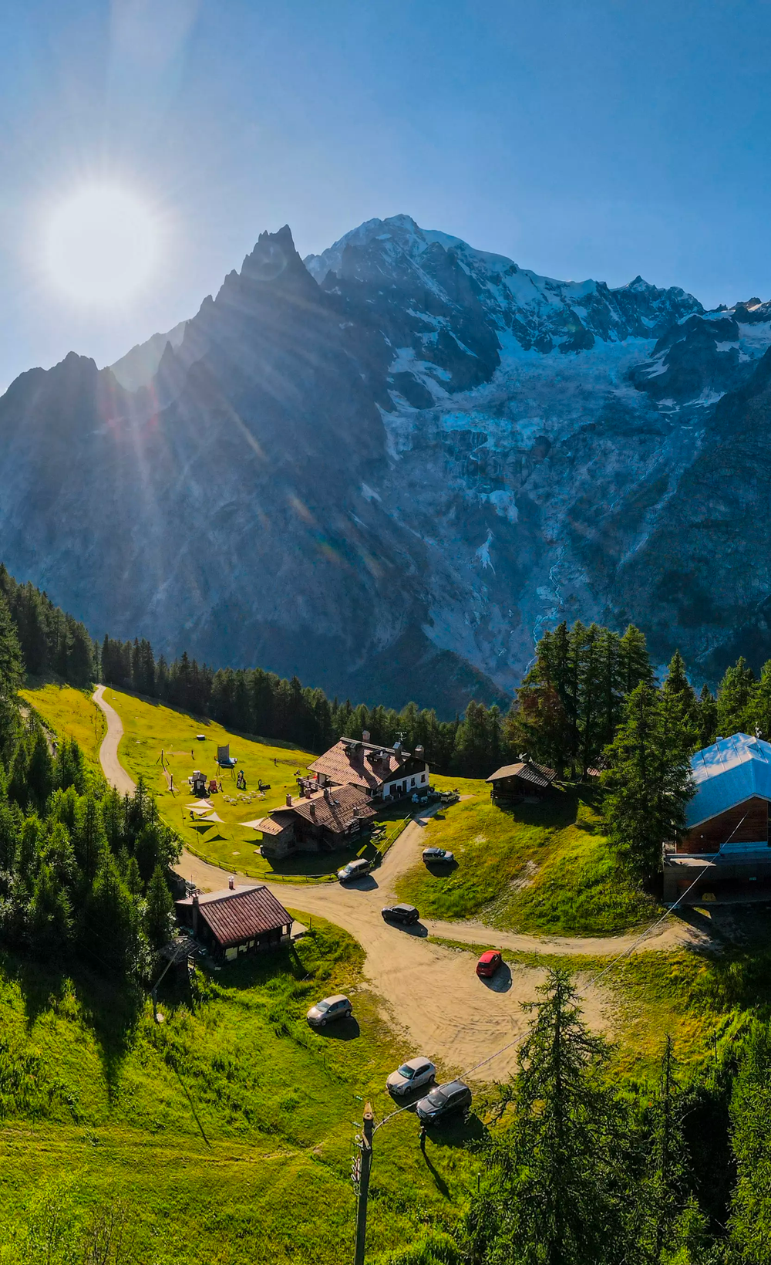
IMPATTI SU QUESTA PROFESSIONE
IMPATTI SU QUESTA PROFESSIONE
PACKAGED TOURS
DIGITALIZZAZIONE
Presentations are communication tools that can be demonstrations, lectures, speeches, reports, and more. Most of the time, they’re presented before an audience.
ROBOTICA & INTELLIGENZA ARTIFICIALE
CUSTOMIZED TOURS
Presentations are communication tools that can be demonstrations, lectures, speeches, reports, and more. Most of the time, they’re presented before an audience.

Slide 4
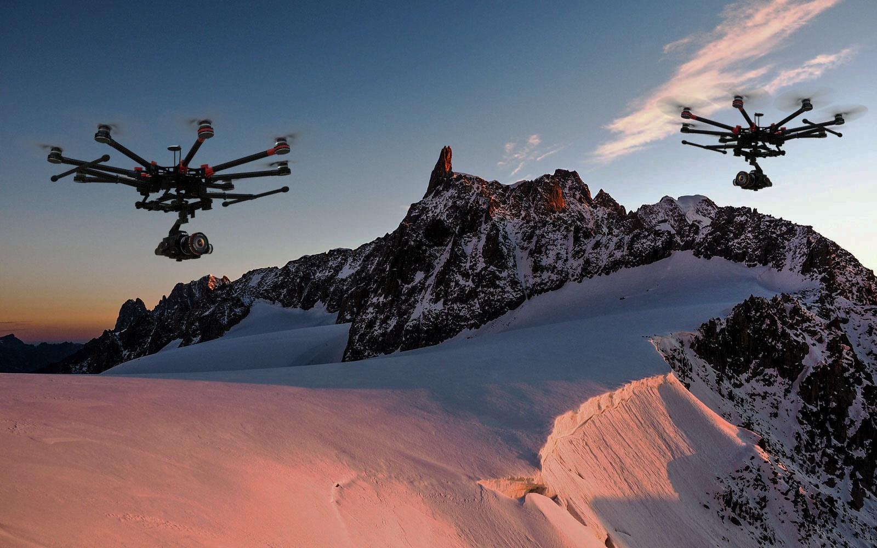
Presentations are communication tools that can be demonstrations, lectures, speeches, reports, and more. Most of the time, they’re presented before an audience.
To create a stunning presentation, it's best to simplify your thoughts. Start with an outline of topics and identify highlights, which can be applied to whatever subject you plan on discussing.
Presentations are communication tools that can be demonstrations, lectures, speeches, reports, and more. Most of the time, they’re presented before an audience.
To create a stunning presentation, it's best to simplify your thoughts. Start with an outline of topics and identify highlights, which can be applied to whatever subject you plan on discussing.
PROFESSIONE DI DOMANI
Presentations are communication tools that can be demonstrations, lectures, speeches, reports, and more. Most of the time, they’re presented before an audience.
To create a stunning presentation, it's best to simplify your thoughts. Start with an outline of topics and identify highlights, which can be applied to whatever subject you plan on discussing.
PROFESSIONE DI DOMANI
PROFESSIONE DI DOMANI
Pilota Droni per manutenzione
Pilota Droni per manutenzione
Pilota Droni per manutenzione
  Diminuzione Incidenti sul lavoro
  Aumento efficacia
  Diminuzione Incidenti sul lavoro
  Aumento efficacia
  Diminuzione Incidenti sul lavoro
  Aumento efficacia
  Riduzione tempi di lavoro
BIJOU TRAVEL & TOURS | 2020
BIJOU TRAVEL & TOURS | 2020

Slide 5
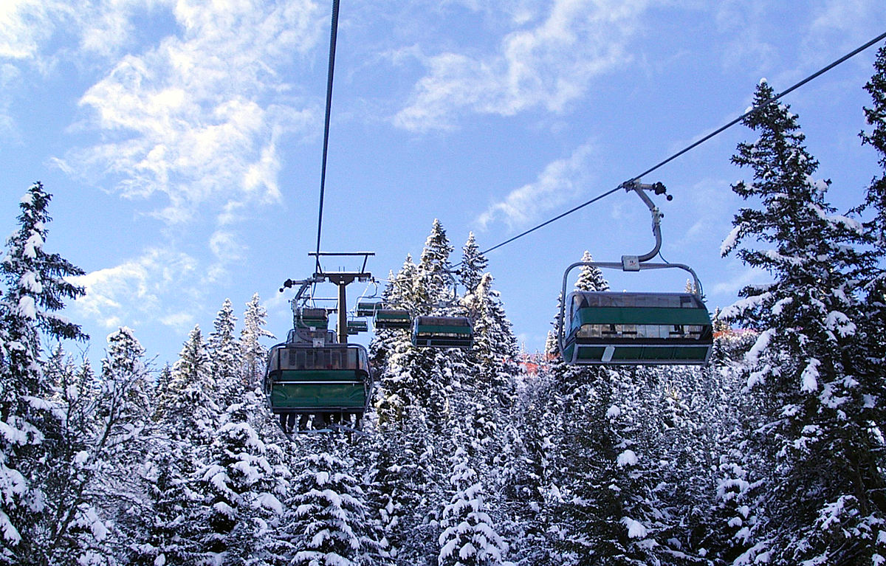
GRAZIE PER LA VOSTRA ATTENZIONE
GRAZIE PER LA VOSTRA ATTENZIONE

